Slide 1


SMART AGRICUTLURE
Sponsored By
Your Team Name : Innovator
Your team bio : Jnaneshwar B.T.
Date : 7th Apr 2023

Slide 2
Problem Statement
Agriculture is an important sector of the global economy, farmers face several challenges and problems which can result in crop failures, reduced yields, and loss of livelihoods for farmers and impacts on economical growth.
Climate change is impacting agriculture in various ways, like erratic weather patterns, extreme temperatures, prolonged droughts, and increased frequency of natural disasters.
Limited access to water resources, over-extraction of groundwater, and inefficient water management practices can lead to water scarcity in agricultural regions.
Soil degradation, caused by factors such as erosion, nutrient depletion, and chemical contamination, can result in reduced soil fertility.
Agricultural practices can have negative environmental impacts, such as deforestation, water pollution, and excessive use of fertilizers and pesticides.
Pests and diseases can significantly impact crops and livestock.
Farmers often face challenges in accessing markets, both domestically and internationally.
The technology and innovation gap can hinder agricultural productivity and limit farmers' ability to adapt to changing environmental conditions.
Many farmers face challenges related to rural poverty &
Labor shortages in agriculture.
Habitat loss: Agricultural expansion can lead to deforestation, conversion of natural habitats, and fragmentation of wildlife habitats, resulting in loss of wildlife habitat, displacement of wildlife populations, and decline in biodiversity
Agricultural policies and governance can significantly impact the agricultural sector. Issues such as land tenure, access to credit, trade policies, and agricultural subsidies can affect farmers' ability to access resources, compete in markets, and adopt sustainable practices.

Slide 3
User Segment & Pain Points
Farmers : Farmers are not upgraded to modern technology and face many challenges accessibility to market. If they use IoT based solution, will increase the productivity and can export their product globally.
Agriculture supply Chain. It is sequence of activities involved in producing, processing, storing, transporting, and distributing agricultural products from farm to consumer. It encompasses all the steps and stakeholders involved in the journey of agricultural products, including farmers, producers, processors, distributors, retailers, and consumers.
Warehouse Management: In the ware house, monitor and maintain the environmental conditions like temperature, humidity and air quality, security system.

Slide 4
Pre-Requisite
Drone. Shall be used to sprinkled water & presiside .
Protecting the agriculture crops from wild life.
Robotic Arm in Wearhouse.
IoT Environmental monitoring system.
Software for electric Agri vehicles.
Database Server, Web Server, Azure framework.
Sensors, Hardware boards, Touch Screen display, OS, High End Development machine, Development tools, compiler, linker debugger. Server Machine.
License Keys.
Fund.

Slide 5
Tools or resources
Azure IoT Hub.
Azure IoT Edge : Artificial Intelligence
Azure Stream Analytics.
Azure Time Series Insights
Azure IoT Central.
Azure IoT Device Provisioning Service
Sensors, Hardware boards, Touch Screen display, OS, High End Development machine, Development tools, compiler, linker debugger. Server Machine. Oscilloscope

Slide 6
Any Supporting Functional Documents

Slide 7
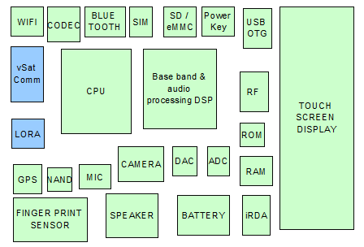
Key Differentiators & Adoption Plan
Water Level Sensor
Temperature Sensor
Soil Moisture Sensor
Light Sensor

Slide 8
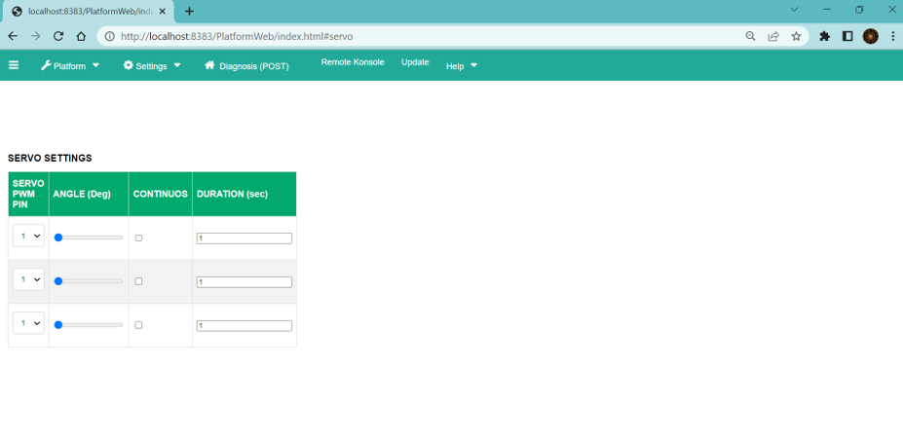
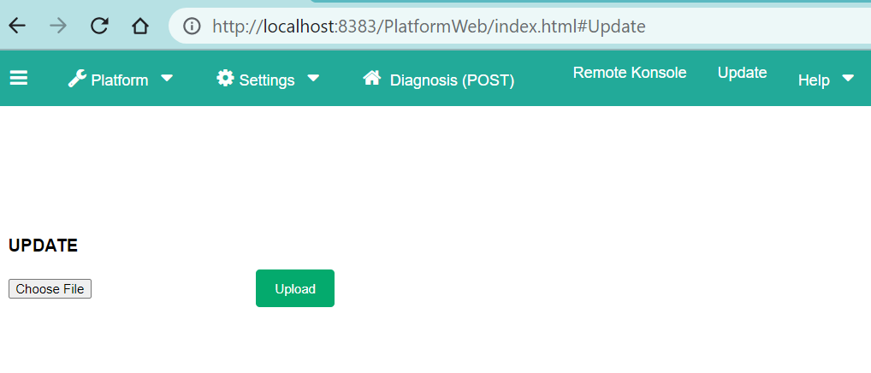
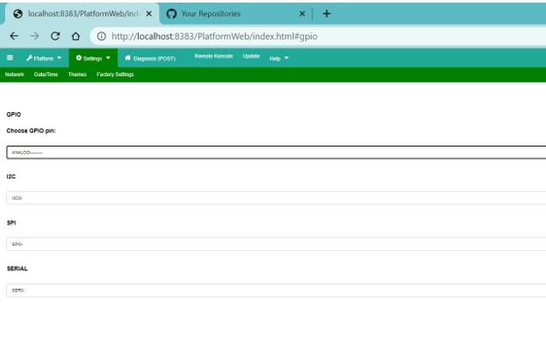
GitHub Repository Link & supporting diagrams, screenshots, if any
Web based Device control panel for developer

Slide 9
Thank You
Jnaneshwar B.T.

